Slide 1
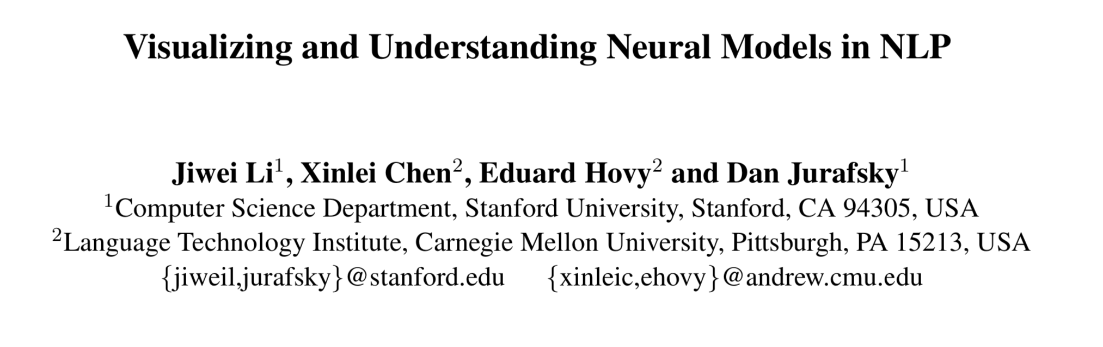
Presented by Shuang Guo

Slide 2
Motivation
Explore the compositionality in NLP neural network models
negation
intensification
concessive clauses

Slide 3
Using Visualization
Two Tasks
Stanford Sentiment Treebank, classification task
WMT’14, autoencoder, Seq2Seq task
Three Models
standard RNN
LSTM
Bi-LSTM
Values to plot
Representation
First-Derivative Saliency
Average and Variance

Slide 4
Tasks
Sentiment Classification
Stanford Sentiment Treebank
fine-grained (very positive, positive, neutral, negative and very negative) and coarse-grained (positive vs negative) classification
Seq2Seq autoencoder
WMT’14 corpus containing 4 million English sentences with an average length of 22.5 words.
inputs and outputs are identical

Slide 5
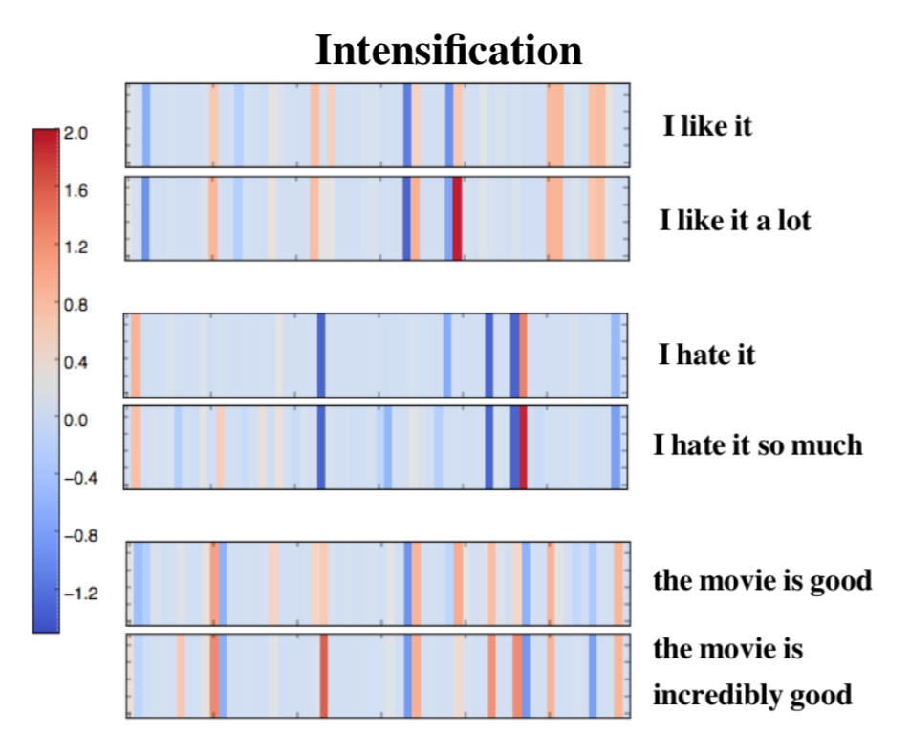
Representation Plotting: Local Composition
The intensification part shows suggestive patterns where values for a few dimensions are strengthened by modifiers like “a lot” (the red bar in the first example) “so much” (the red bar in the second example), and “incredibly”.
Notes:
Visualizing intensification and negation. Each vertical bar shows the value of one dimension in the final sentence/phrase representation after compositions. Em- beddings for phrases or sentences are attained by composing word representations from the pretrained model.

Slide 6
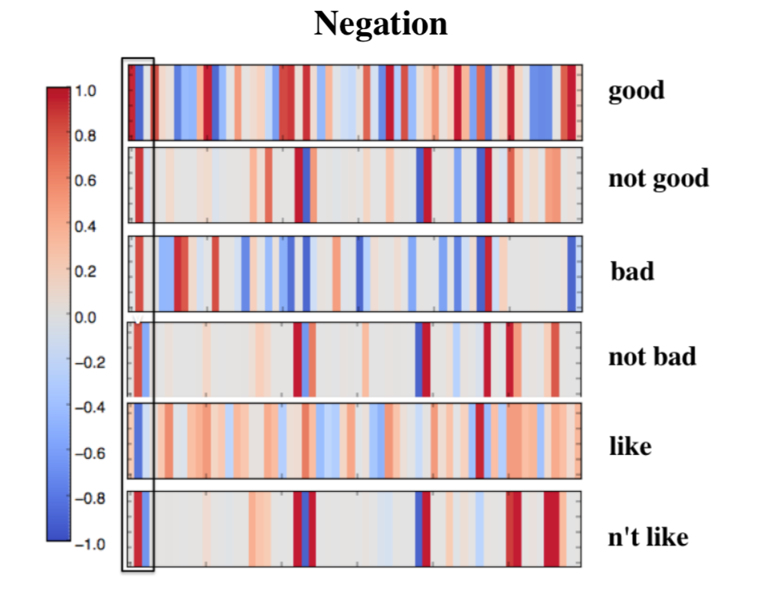
Representation Plotting: Local Composition
Though the patterns for negations are not as clear, there is still a consistent reversal for some dimensions, visible as a shift between blue and red for dimensions boxed on the left.
Notes:
Visualizing intensification and negation. Each vertical bar shows the value of one dimension in the final sentence/phrase representation after compositions. Em- beddings for phrases or sentences are attained by composing word representations from the pretrained model.

Slide 7
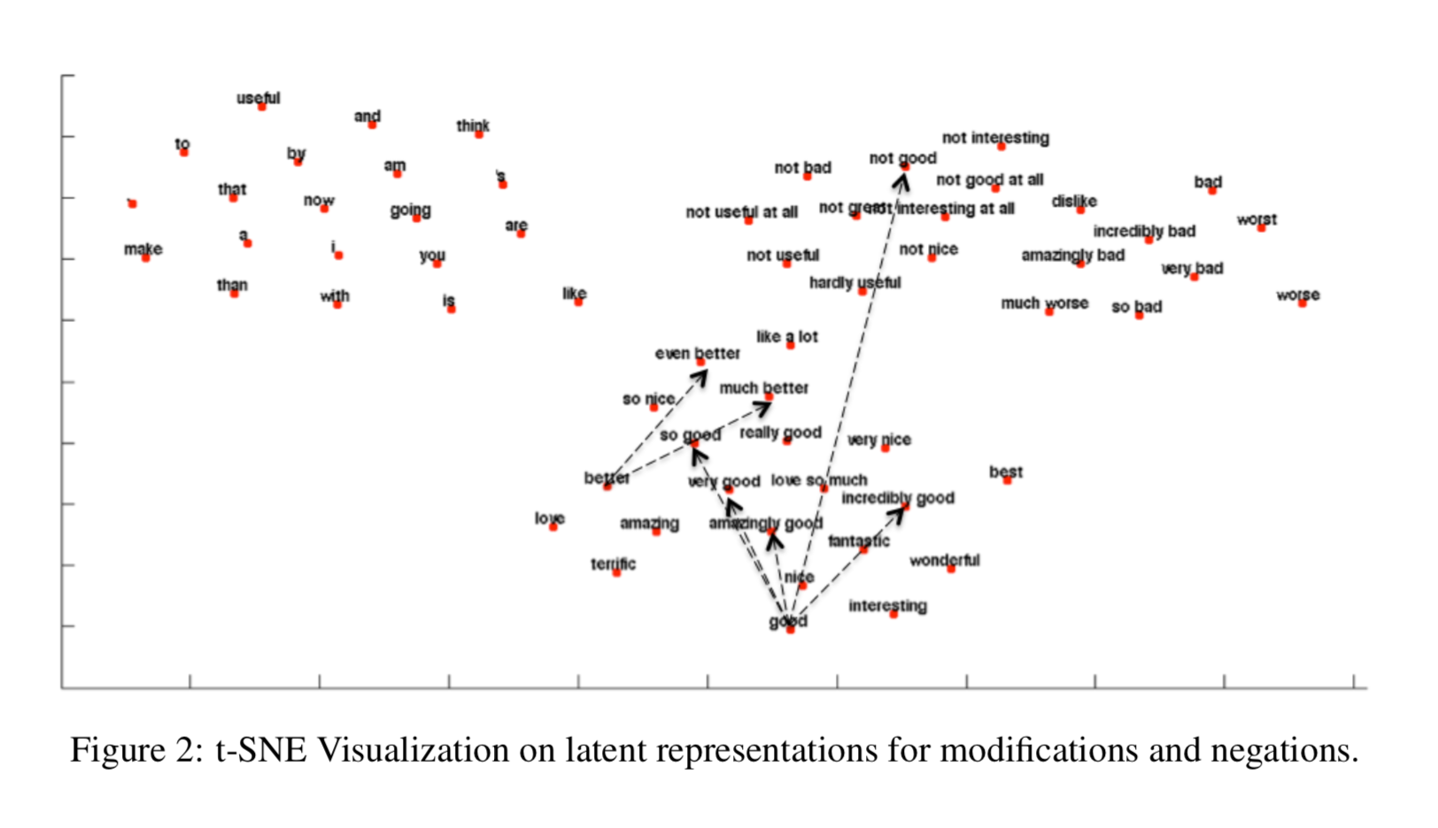
Representation Plotting: Local Composition
As can be seen, neural models nicely learn the properties of local compositionally, clustering negation+positive words (‘not nice’, ’not good’) together with negative words.
Notes:
t-SNE Visualization on latent representations for modifications and negations.

Slide 8
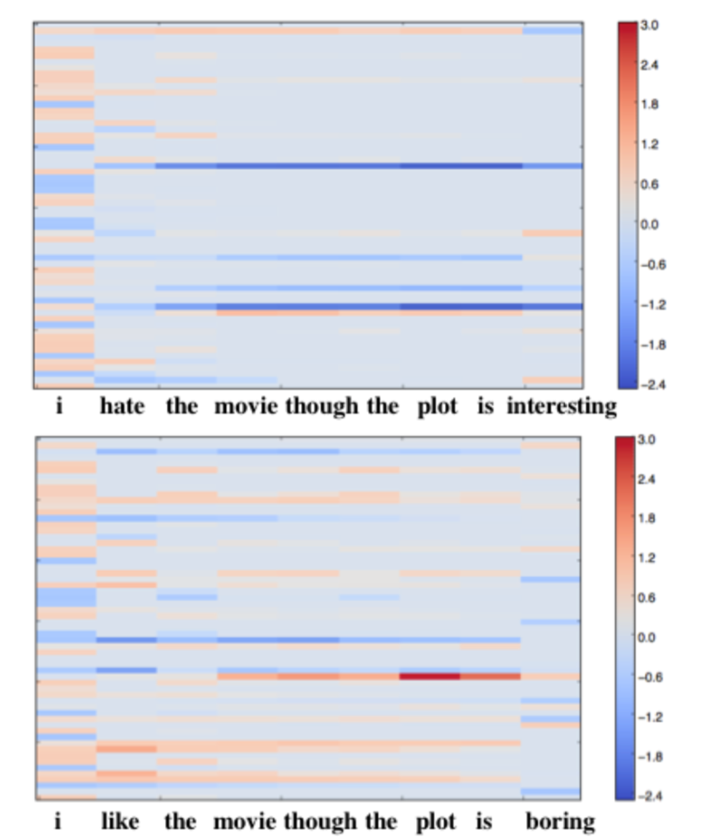
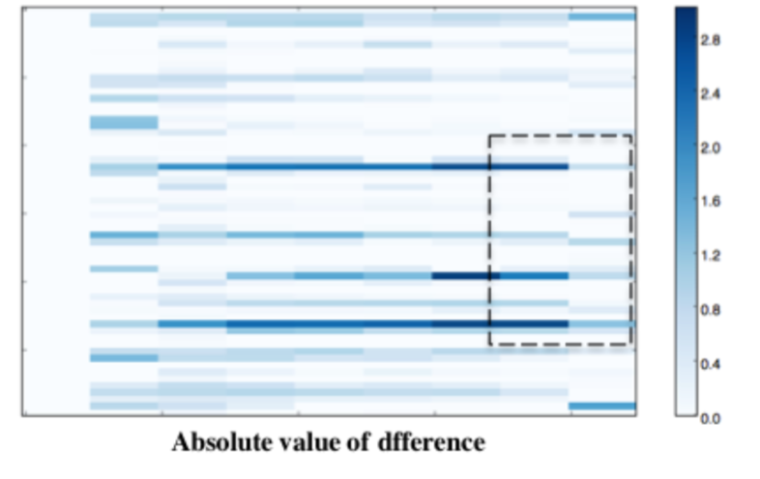
Representation Plotting: Concessive Clause
Representations over time from LSTMs.
Each column corresponds to outputs from LSTM at each time-step (representations obtained after combining current word embedding with previous build embeddings).
Each grid from the column corresponds to each dimension of current time-step representation.
The last rows correspond to absolute differences for each time step between two sequences.

Slide 9
Representation Plotting: Concessive Clause
For tasks like sentiment analysis whose goal is to predict a specific semantic dimension (as opposed to general tasks like language model word prediction), too large a dimensionality leads to many dimensions non-functional (with values close to 0), causing two sentences of opposite sentiment to differ only in a few dimensions.
This may explain why more dimensions don’t necessarily lead to better performance on such tasks (For example, as reported in (Socher et al., 2013), optimal performance is achieved when word dimensionality is set to between 25 and 35).

Slide 10
Representation Plotting: Concessive Clause
The difference between the two sentences is diluted when the final words (“interesting” and “boring”) appear.
This implies the stronger one dominating the sentiment

Slide 11
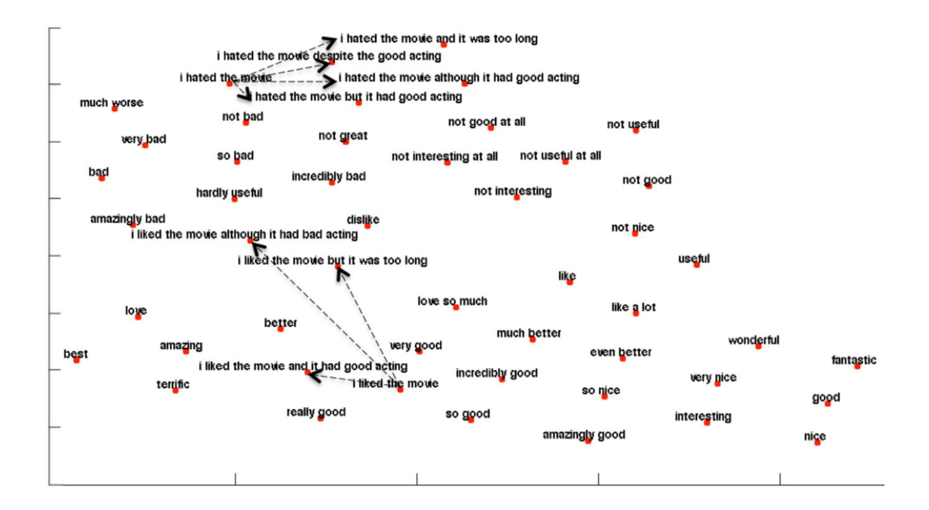
Representation Plotting: Clause Composition

Slide 12
Representation Plotting: Clause Composition
Representations move closer to the negative sentiment region by adding negative clauses like “although it had bad acting” or “but it is too long” to the end of a simply positive “I like the movie”.
By contrast, adding a concessive clause to a negative clause does not move toward the positive; “I hate X but ...” is still very negative, not that different than “I hate X”.

Slide 13
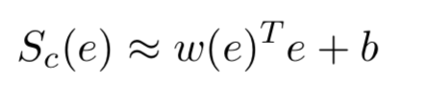
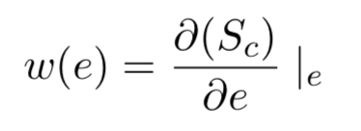
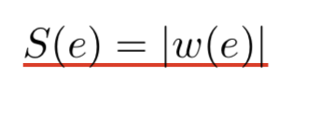
First-Derivative Saliency
The magnitude (absolute value) of the derivative indicates the sensitiveness of the final decision to the change in one particular dimension, telling us how much one specific dimension of the word embedding contributes to the final decision.

Slide 14
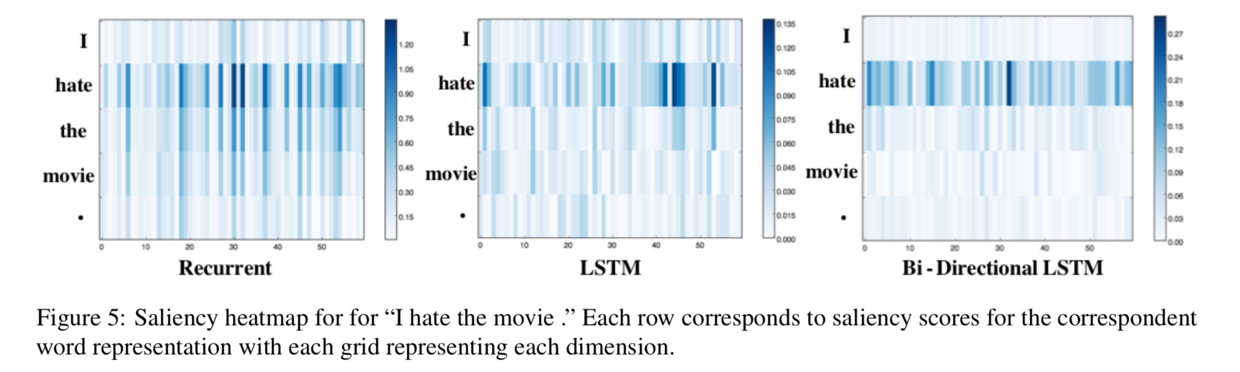
First-Derivative Saliency
All three models assign high saliency to “hate” and dampen the influence of other tokens. LSTM offers a clearer focus on “hate” than the standard recurrent model, but the bi-directional LSTM shows the clearest focus, attaching almost zero emphasis on words other than “hate”. This is presumably due to the gates structures in LSTMs and Bi-LSTMs that controls information flow.

Slide 15
First-Derivative Saliency
None of the models suffer from the gradient vanishing problems despite this sentence being longer; the salience of “hate” still stands out after 7-8 following convolutional operations.

Slide 16
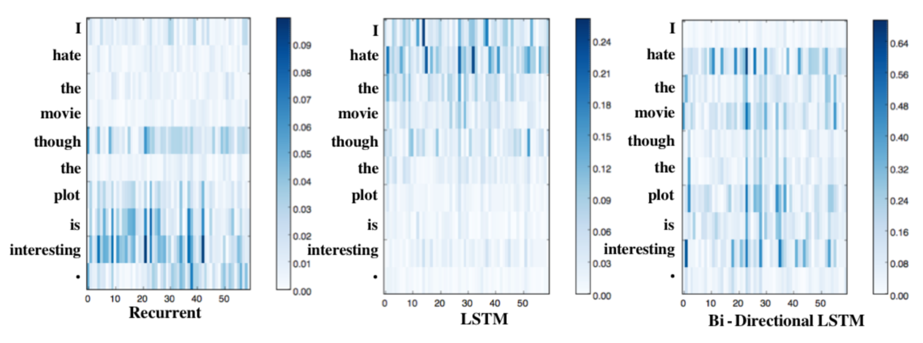
First-Derivative Saliency
The simple recurrent model emphasizes only the second clause “the plot is interesting”, assigning no credit to the first clause “I hate the movie”. This might seem to be caused by a vanishing gradient, yet the model correctly classifies the sentence as very negative, suggesting that it is successfully incorporating information from the first negative clause.

Slide 17
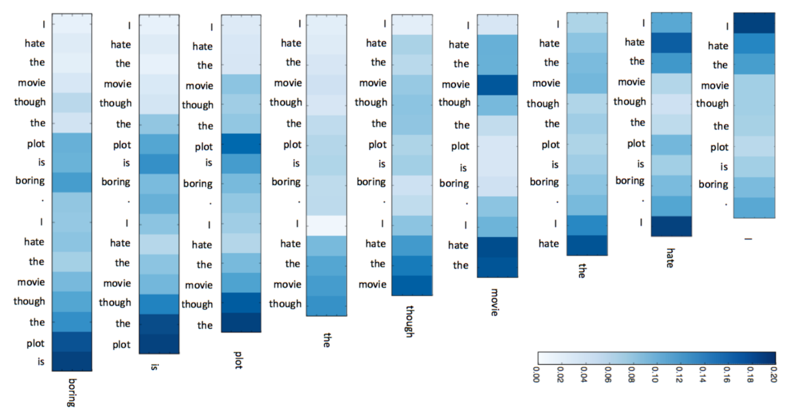
First-Derivative Saliency: Seq2Seq

Slide 18
First-Derivative Saliency: Seq2Seq
Input region centering around token “hate” exerts more impact when token “hate” is to be predicted, similar cases with tokens “movie”, “plot” and “boring”.
As decoding proceeds, the influence of the initial input on decoding (i.e., tokens in source sentences) gradually diminishes as more previously-predicted words are encoded in the vector representations. Meanwhile, the influence of language model gradually dominates: when word “boring” is to be predicted, models attach more weight to earlier predicted tokens “plot” and “is” but less to correspondent regions in the inputs, i.e., the word “boring” in inputs.

Slide 19
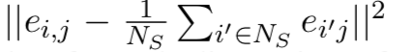
Average and Variance
For settings where word embeddings are treated as parameters to optimize from scratch, calculate variance:
where e(i,j) denotes the value for j-th dimension of word i and N denotes the number of token within the sentences.

Slide 20
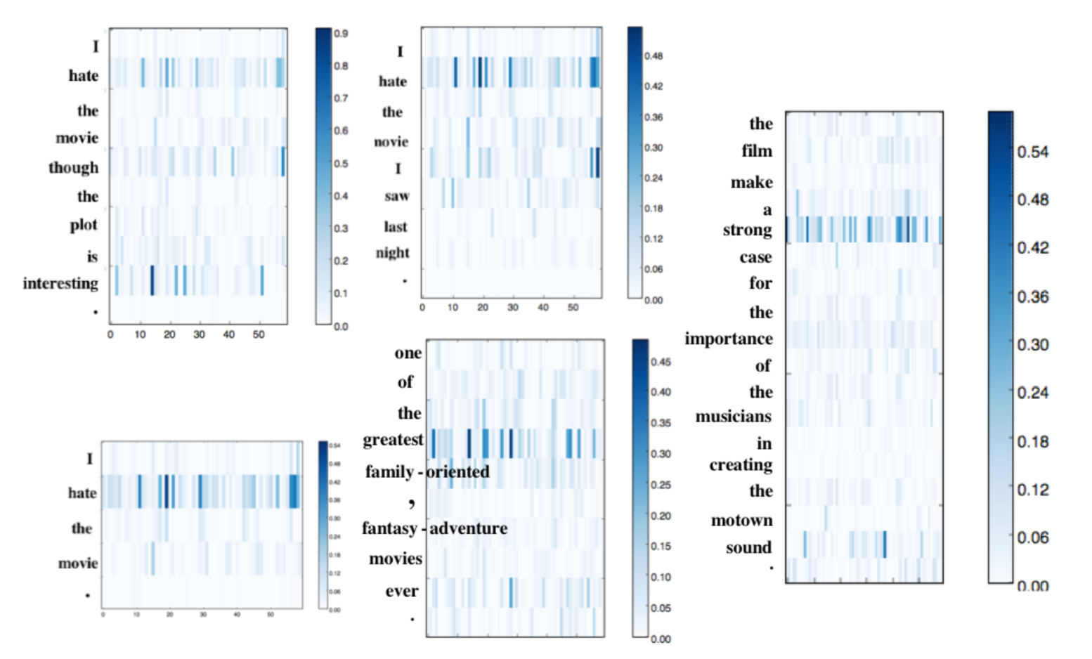
Average and Variance
As the figure shows, the variance-based salience measure also does a good job of emphasizing the relevant sentiment words

Slide 21
Conclusion
offer several methods to help visualize and interpret neural models
understand how neural models are able to compose meanings
demonstrating asymmetries of negation and explain some aspects of the strong performance of LSTMs at these tasks

Slide 22
Future work
using results of the visualization be used to perform error analysis
understanding strengths limitations of different neural models

